Slide 2
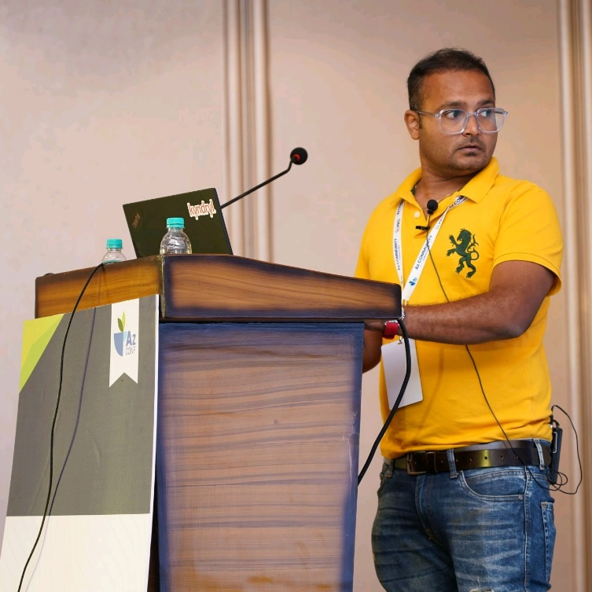
ANURAG SINGH
Director of IT, GenAI
Honeywell Technology Solutions Lab

Slide 3
Architecture patterns for building GenAI applications

Slide 4
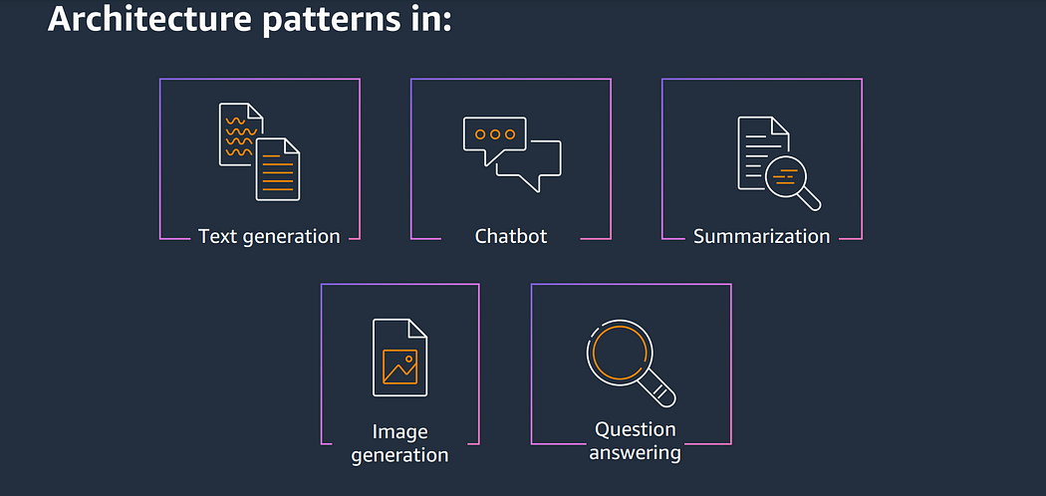
Most Common Usage Patterns for GenAI
Architecture Pattern

Slide 5
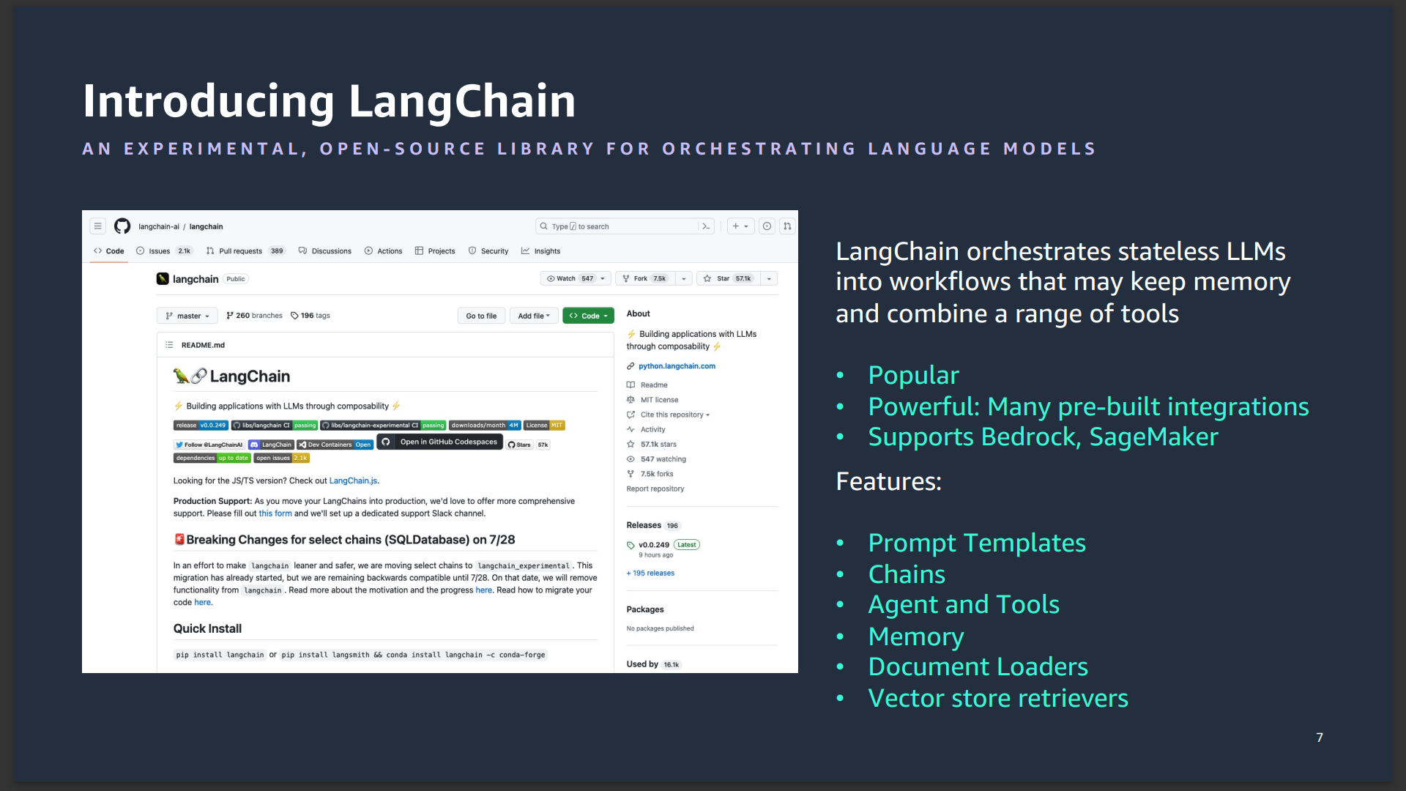
Langchain

Slide 6
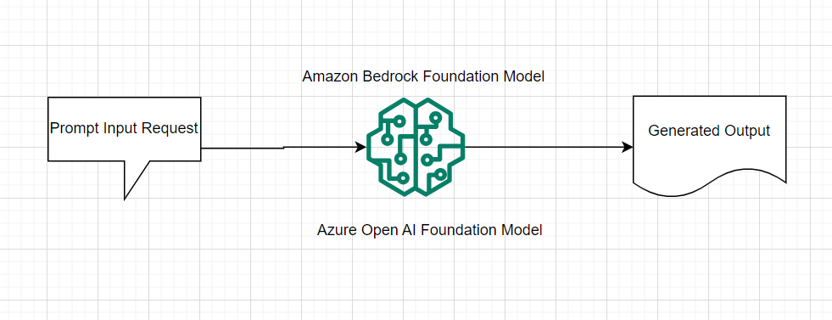
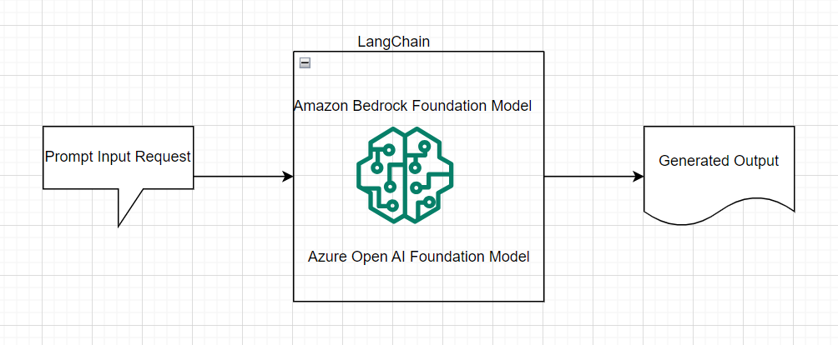
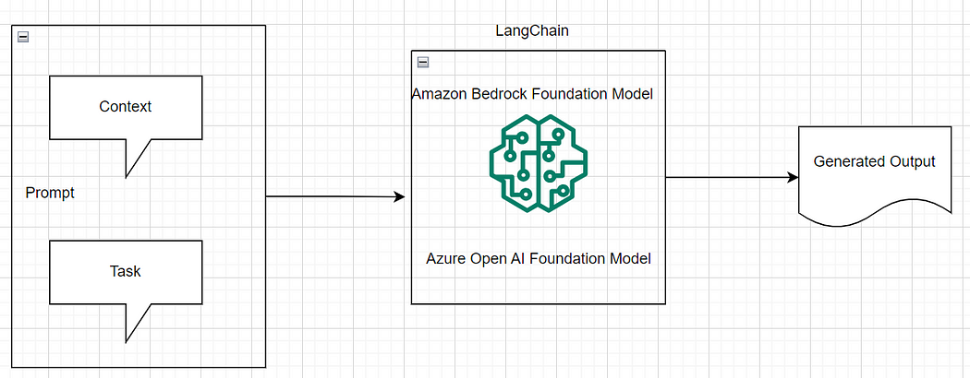
Architecture Patterns for Text Generation
Text Generation with Simple Prompt
Text Generation with LangChain
Text Generation with Context & LangChain

Slide 7
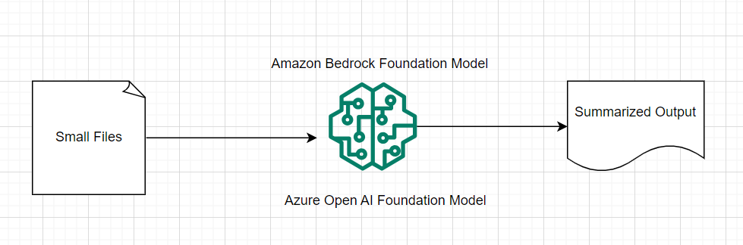
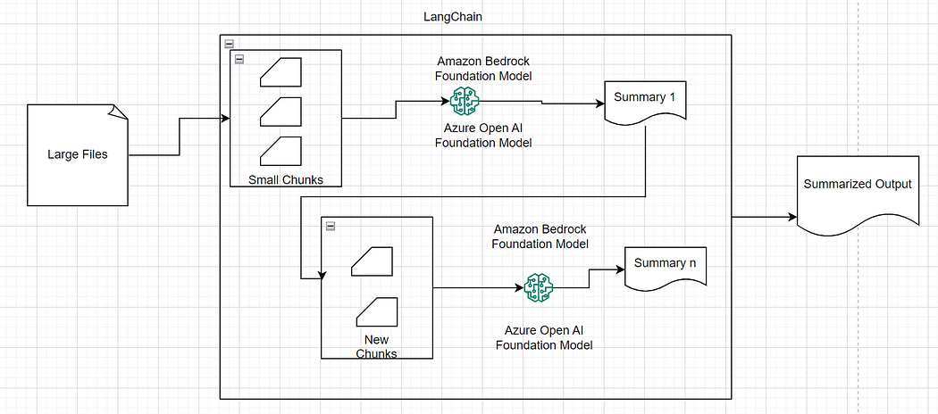
Architecture Patterns for Text Summarization
Text Summarization with Small Files
Text Summarization with Large Files & LangChain

Slide 8
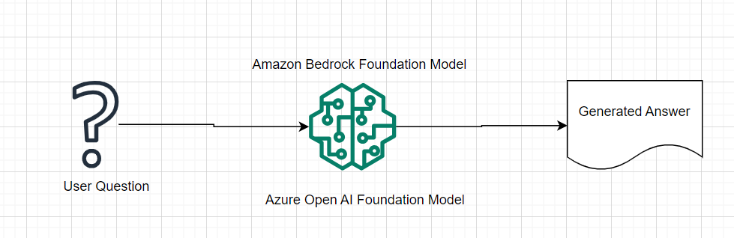
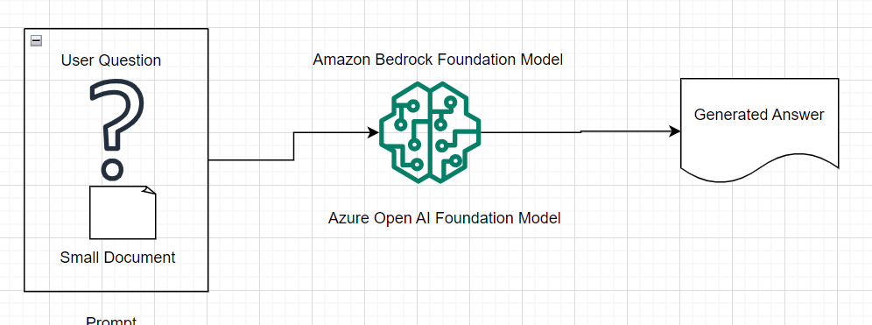
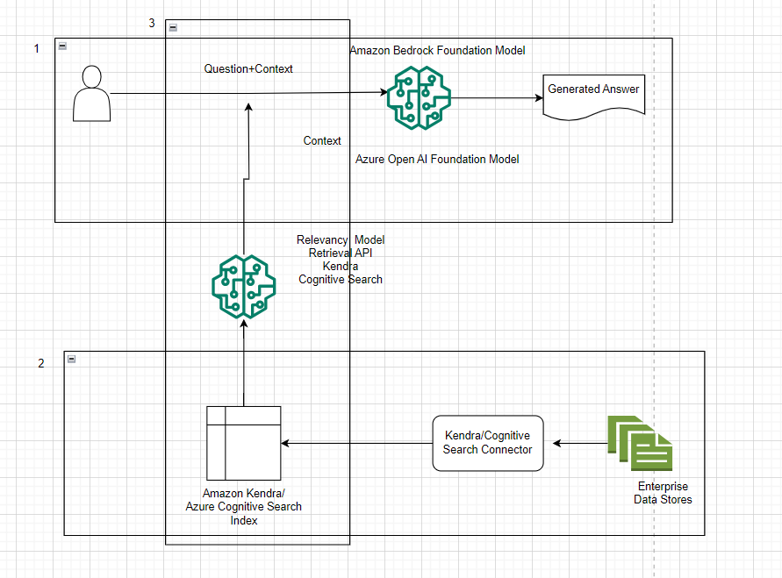
Architecture Patterns for Question Answer
Question Answer with Simple Prompt
Question Answer with Context
Question Answering with Retrieval-Augmented Generation(RAG) via Search Engine

Slide 9
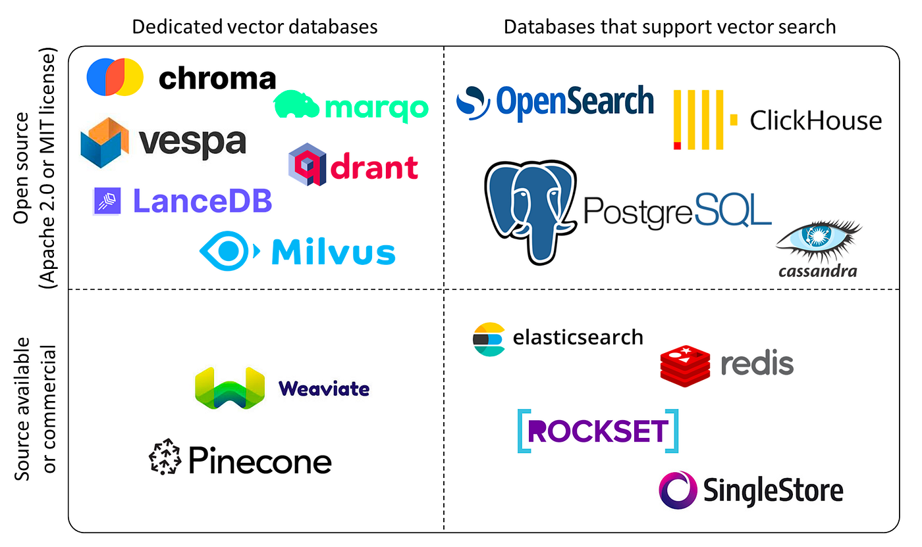
Few Vector Databases

Slide 10
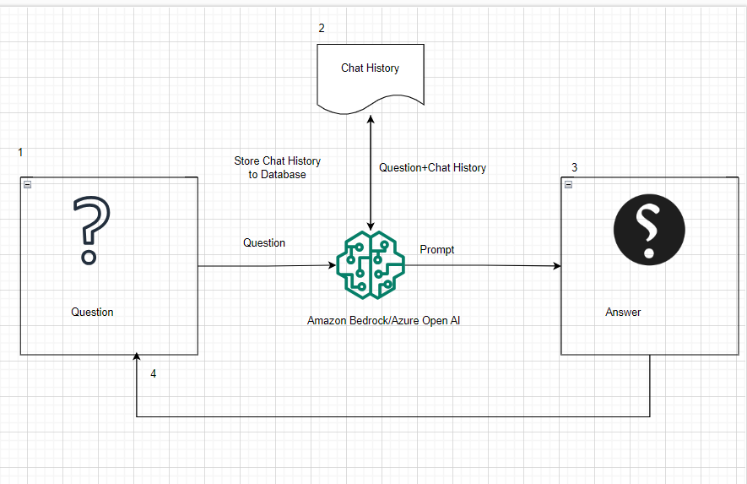
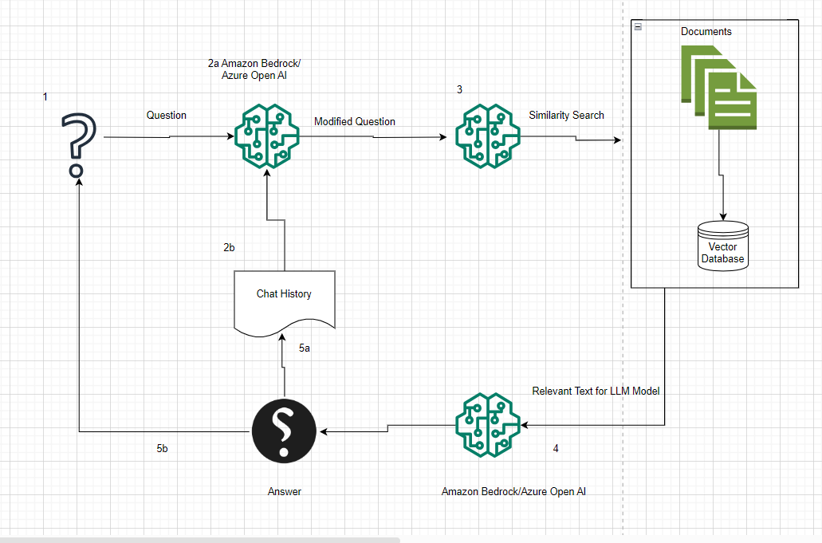
Architecture Patterns for Chatbot
Basic Chatbot
Chatbot with Context

Slide 11
Success with Gen AI is not just about getting the right architecture or even the right technology. It’s also about the people—both technical and non-technical—their skills and capabilities, their data and AI literacy, and the way they would work with the new technologies day-to-day.

Slide 12





Platinum Partner
Gold Partner
Silver Partner

Slide 13
Thank You!

Slide 14
Questions
anukaushalsingh@gmail.com
https://www.linkedin.com/in/anuragsinghdatasciencebigdata/
https://medium.com/@anuragsingh6701

